Slide 1
Operating Systems(CS301)
Course Overview
Overview
Operating Systems (OS) Objectives, Formal Definition, Evolution, Types,DMA & Multiprogramming - OS Interfaces - The Command-less command interpreter systems - Device drivers - Examples
Processes and Threads
Process Management: The process concept - Programs, Processes & Threads – Process Control Block – PCB as a data structure in contemporary operating systems - Process Hierarchy - System Calls - CPU Scheduling & algorithms. Metrics - Examples
Concurrency: Mutual Exclusion and Synchronization
Concurrent processes - The Critical Section & Mutual Exclusion problem - Algorithms - Semaphores, Critical Region, Conditional Critical Region, Monitors, Messages - Examples in Contemporary OS - Classical Process Coordination Problems. Deadlocks: Characterization - Prevention - Avoidance - Detection - Recovery - Combined Approach to Deadlock handling & Deadlock Handling in contemporary OS.
Concurrency: Deadlock and Starvation
Principles of Concurrency, Mutual Exclusion, Semaphores, Monitors, Message Passing, Readers/Writers Problem
Scheduling
Uniprocessor Scheduling: Long Term Scheduling, Medium Term Scheduling, Short Term Scheduling, Scheduling Algorithms: Short Term Scheduling Criteria, Use of Priorities, Alternative Scheduling Policies, Performance Comparison, Fair-Share Scheduling. Multiprocessor Scheduling:Granularity, Design Issue, Process Scheduling, Thread Scheduling, Real-Time Scheduling: Characteristics of RTOS, Real-Time Scheduling, Deadline Scheduling, Rate Monotonic Scheduling, Priority Inversion. Case Study: Linux & Windows Scheduling.

Slide 2
Memory Management
Memory Hierarchy, Static and Dynamic Memory Allocation, Overview of Swapping, Multiple Partitions Contiguous and Non-Contiguous Memory Allocation, Concepts of Paging, Segmentation.
Virtual Memory
Virtual Memory Concepts - Demand paging - Performance - Fragmentation & Compaction. Page replacement and Allocation algorithms -Memory Protection - System Calls – Linux/Windows Virtual Memory Techniques.
I/O management and disk scheduling
Terminals & Capability Databases - Emulators - Virtual Terminals - Disk Devices - Device Independence - Free space management - Performance and Reliability - Storage hierarchy.
File Management
Levels - File Systems in Disk Partitions - File-naming & File Access - Allocation strategies - Directory systems & their implementations - File Systems to device drivers - File Systems Reliability – Examples of fsck() and fsdb() utilities - File protection - Implementation issues

Slide 3
BOOKS RECOMMENDED
1)Silberschatz A & Galvin: “Operating System Concepts”, John Wiley & Sons 2)W. Stallings: “Operating Systems: Internals and Design Principles”, Pearson Pub. 3)Andrew S Tanenbaum & A Woodhul;: “Operating Systems - Design and Implementation”, PHI EEE 4)Crawley: “Operating Systems - An Object oriented Approach”, McGraw Hill 5)Kernighan & Pike: “UNIX programming Environment”, PHI-EEE

Slide 4
Overview

Slide 5
What is an Operating System?
A program that acts as an intermediary between a user of a computer and the computer hardware.
A program that controls the execution of application programs
An interface between applications and hardware
Operating system goals:
Execute user programs and make solving user problems easier.
Make the computer system convenient to use.
Use the computer hardware in an efficient manner.

Slide 6
Operating System Objectives
Convenience
Efficiency
Ability to evolve
Notes:
‹#›

Slide 7
Computer System Structure
Computer system can be divided into four components
Hardware – provides basic computing resources
CPU, memory, I/O devices
Operating system
Controls and coordinates use of hardware among various applications and users
Application programs – define the ways in which the system resources are used to solve the computing problems of the users
Word processors, compilers, web browsers, database systems, video games
Users
People, machines, other computers

Slide 8
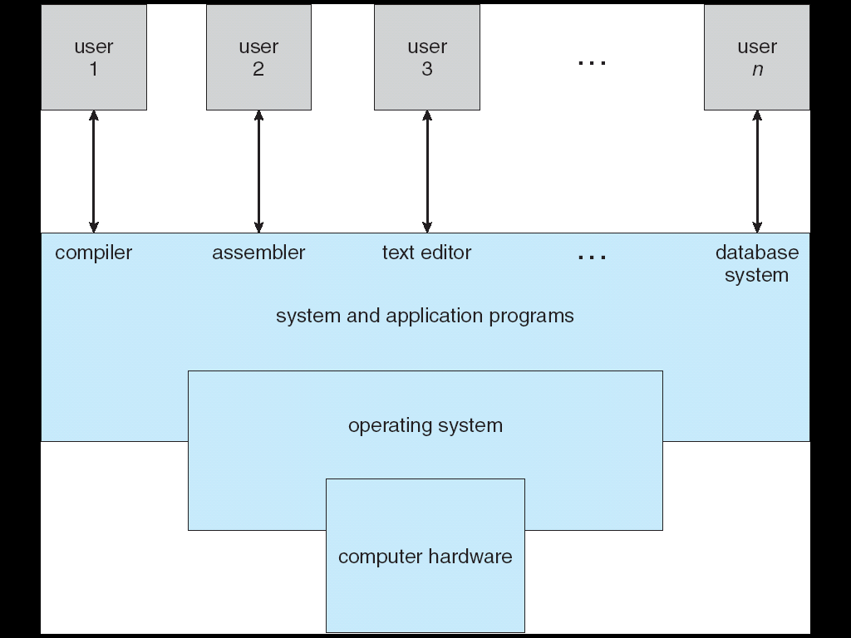
Four Components of a Computer System

Slide 9
Operating System Definition
OS is a resource allocator
Manages all resources
Decides between conflicting requests for efficient and fair resource use
OS is a control program
Controls execution of programs to prevent errors and improper use of the computer
No universally accepted definition
“Everything a vendor ships when you order an operating system” is good approximation
But varies wildly

Slide 10
Kernel
“The one program running at all times on the computer” is the kernel. Everything else is either a system program (ships with the operating system) or an application program
Portion of operating system that is in main memory
Contains most frequently used functions
Also called the nucleus
Notes:
‹#›

Slide 11
Evolution of Operating Systems
Hardware upgrades plus new types of hardware
New services
Fixes
Notes:
‹#›

Slide 12
Evolution of Operating Systems
(1) Serial processing
No operating system
Machines run from a console with display lights, toggle switches, input device, and printer
Schedule time
Setup included loading the compiler, source program, saving compiled program, and loading and linking
Notes:
‹#›

Slide 13
Evolution of Operating Systems
(2) Simple batch system
Monitor
Software that controls the sequence of events
Batch jobs together
Program returns control to monitor when finished
Notes:
‹#›

Slide 14
Job Control Language
Special type of programming language
Provides instruction to the monitor
What compiler to use
What data to use
Notes:
‹#›

Slide 15
Hardware Features
Memory protection
Does not allow the memory area containing the monitor to be altered
Timer
Prevents a job from monopolizing the system
Privileged instructions
Certain machine level instructions can only be executed by the monitor
Interrupts
Early computer models did not have this capability
Notes:
‹#›

Slide 16
Memory Protection
User program executes in user mode
Certain instructions may not be executed
Monitor executes in system mode
Kernel mode
Privileged instructions are executed
Protected areas of memory may be accessed
Notes:
‹#›

Slide 17

(3) Multiprogrammed Batch systems
Uniprogramming -
Processor must wait for I/O instruction to complete before proceeding
Notes:
‹#›

Slide 18
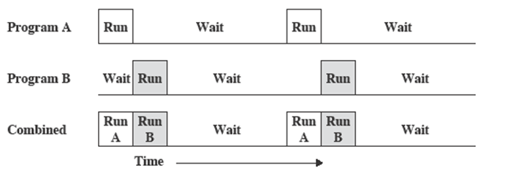
Multiprogramming with two programs
When one job needs to wait for I/O, the processor can switch to the other job
Notes:
‹#›

Slide 19
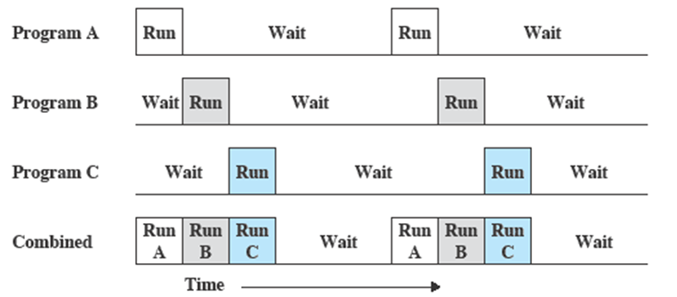
Multiprogramming with three programs
Notes:
‹#›

Slide 20
(4) Time Sharing Systems
Using multiprogramming to handle multiple interactive jobs
Processor’s time is shared among multiple users – turn by turn…
Multiple users simultaneously access the system through terminals
Notes:
‹#›

Slide 21
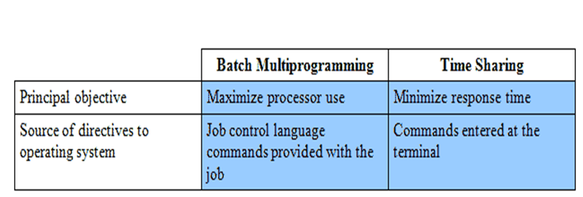
Batch Multiprogramming versus Time Sharing
Notes:
‹#›

Slide 22
Computer Startup
bootstrap program is loaded at power-up or reboot
Typically stored in ROM or EPROM, generally known as firmware
Initializates all aspects of system
Loads operating system kernel and starts execution

Slide 23
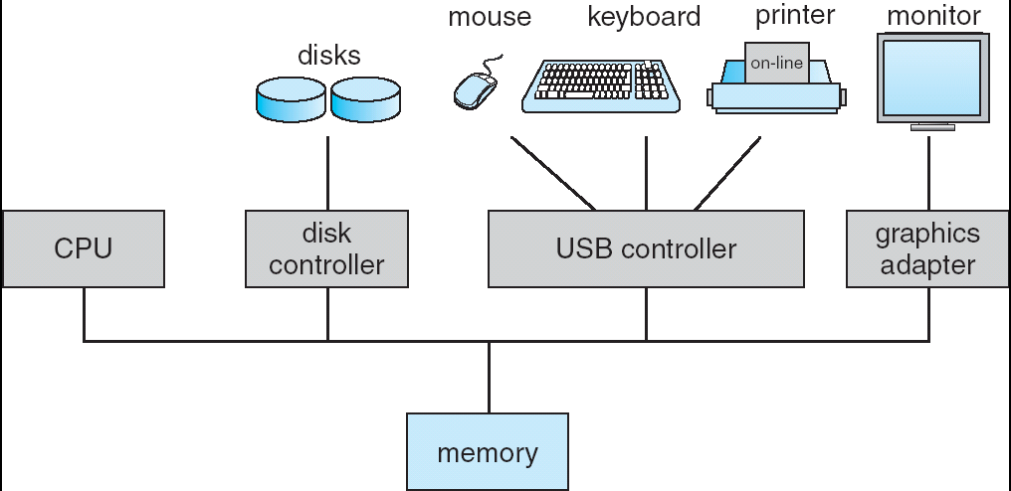
Computer System Organization
Computer-system operation
One or more CPUs, device controllers connect through common bus providing access to shared memory
Concurrent execution of CPUs and devices competing for memory cycles

Slide 24
Computer-System Operation
I/O devices and the CPU can execute concurrently.
Each device controller is in charge of a particular device type.
Each device controller has a local buffer.
CPU moves data from/to main memory to/from local buffers
I/O is from the device to local buffer of controller.
Device controller informs CPU that it has finished its operation by causing an interrupt.

Slide 25
Common Functions of Interrupts
Interrupt transfers control to the interrupt service routine generally, through the interrupt vector, which contains the addresses of all the service routines.
Interrupt architecture must save the address of the interrupted instruction.
Incoming interrupts are disabled while another interrupt is being processed to prevent a lost interrupt.
A trap is a software-generated interrupt caused either by an error or a user request.
An operating system is interrupt driven.

Slide 26
Interrupt Handling
The operating system preserves the state of the CPU by storing registers and the program counter.
Determines which type of interrupt has occurred:
polling
vectored interrupt system
Separate segments of code determine what action should be taken for each type of interrupt

Slide 27
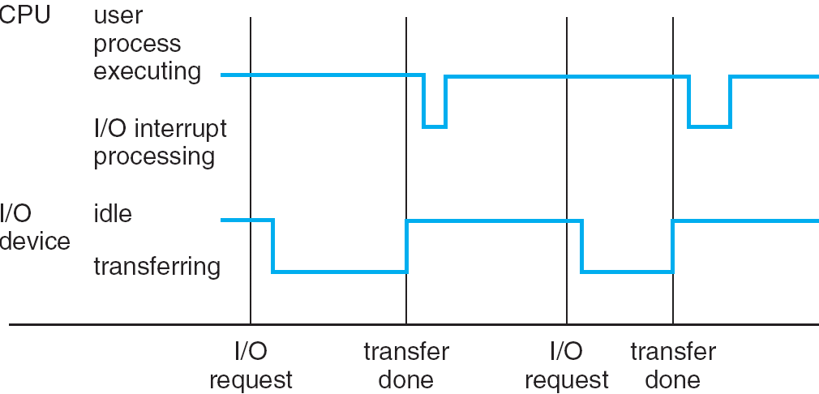
Interrupt Timeline

Slide 28
I/O Structure
After I/O starts, control returns to user program only upon I/O completion.
Wait instruction idles the CPU until the next interrupt
Wait loop (contention for memory access).
At most one I/O request is outstanding at a time, no simultaneous I/O processing.
After I/O starts, control returns to user program without waiting for I/O completion.
System call – request to the operating system to allow user to wait for I/O completion.
Device-status table contains entry for each I/O device indicating its type, address, and state.
Operating system indexes into I/O device table to determine device status and to modify table entry to include interrupt.

Slide 29
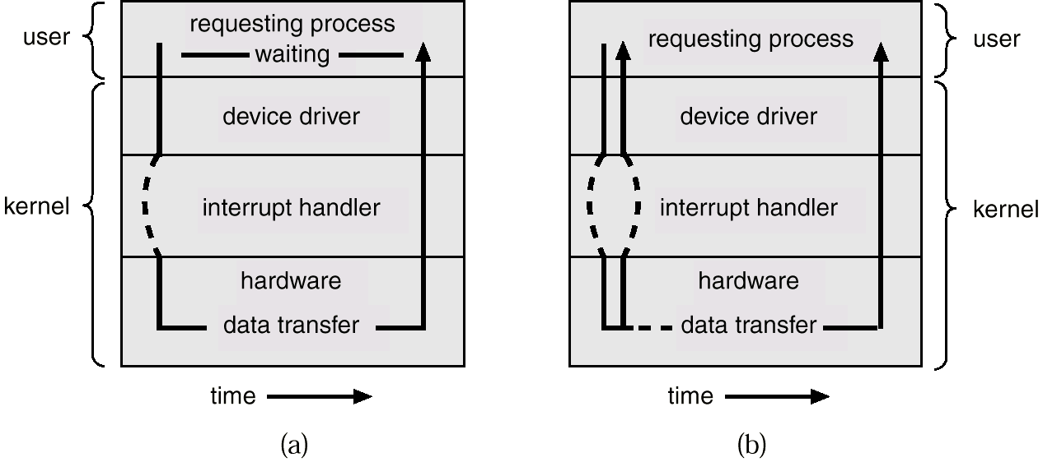
Two I/O Methods
Synchronous
Asynchronous

Slide 30
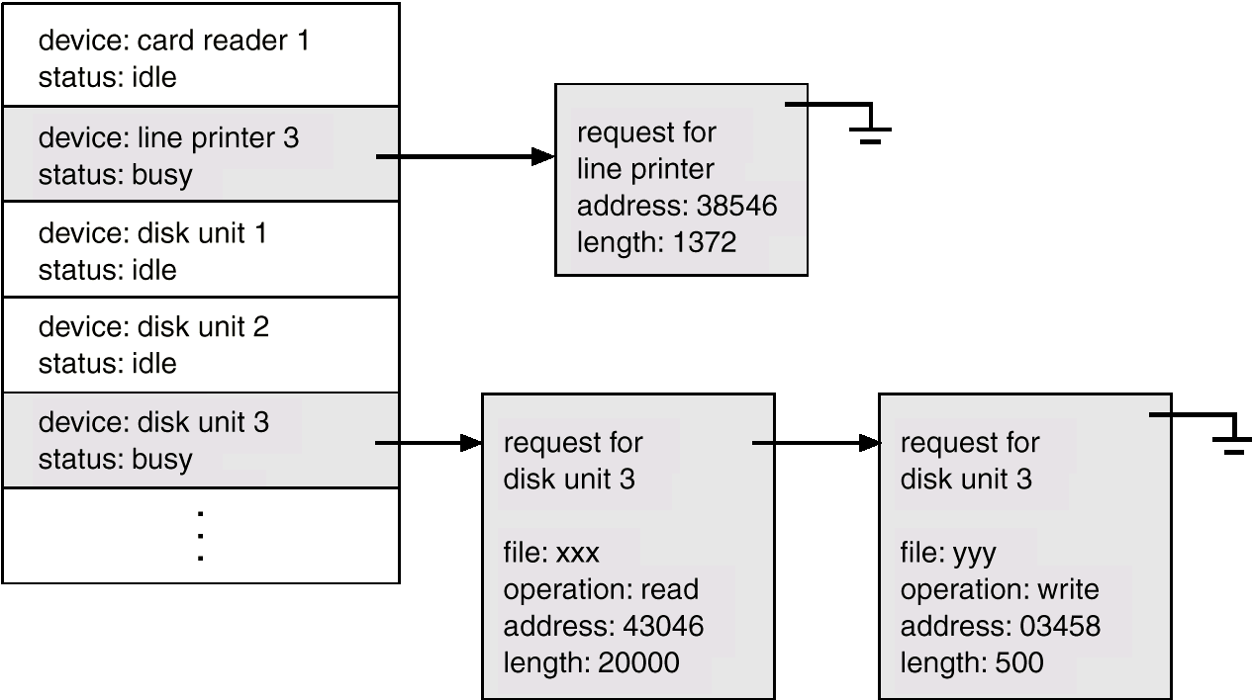
Device-Status Table

Slide 31
Direct Memory Access Structure
Used for high-speed I/O devices able to transmit information at close to memory speeds.
Device controller transfers blocks of data from buffer storage directly to main memory without CPU intervention.
Only one interrupt is generated per block, rather than the one interrupt per byte.

Slide 32
Storage Structure
Main memory – only large storage media that the CPU can access directly.
Secondary storage – extension of main memory that provides large nonvolatile storage capacity.
Magnetic disks – rigid metal or glass platters covered with magnetic recording material
Disk surface is logically divided into tracks, which are subdivided into sectors.
The disk controller determines the logical interaction between the device and the computer.

Slide 33
Storage Hierarchy
Storage systems organized in hierarchy.
Speed
Cost
Volatility
Caching – copying information into faster storage system; main memory can be viewed as a last cache for secondary storage.

Slide 34
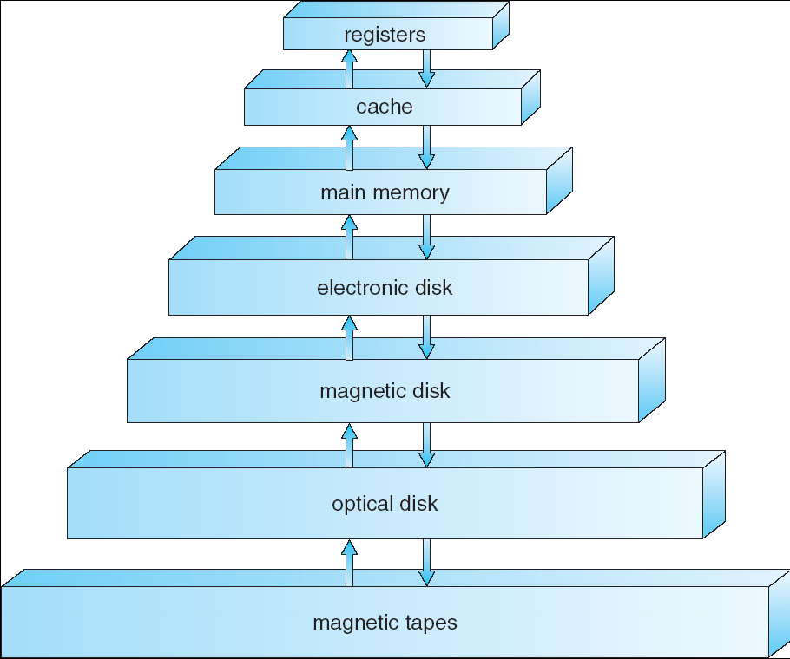
Storage-Device Hierarchy

Slide 35
Caching
Important principle, performed at many levels in a computer (in hardware, operating system, software)
Information in use copied from slower to faster storage temporarily
Faster storage (cache) checked first to determine if information is there
If it is, information used directly from the cache (fast)
If not, data copied to cache and used there
Cache smaller than storage being cached
Cache management important design problem
Cache size and replacement policy

Slide 36
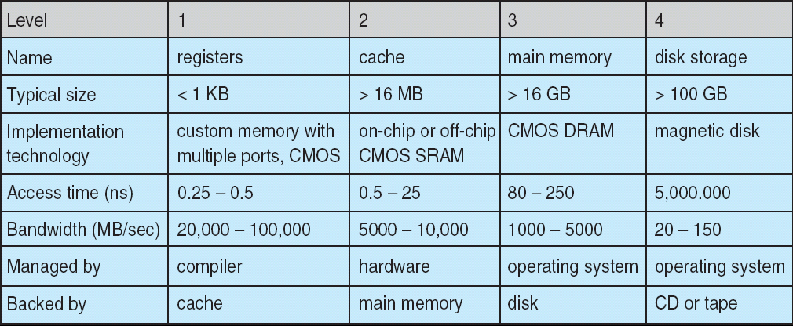
Performance of Various Levels of Storage
Movement between levels of storage hierarchy can be explicit or implicit

Slide 37
Operating System Structure
Multiprogramming needed for efficiency
Single user cannot keep CPU and I/O devices busy at all times
Multiprogramming organizes jobs (code and data) so CPU always has one to execute
A subset of total jobs in system is kept in memory
One job selected and run via job scheduling
When it has to wait (for I/O for example), OS switches to another job
Timesharing (multitasking) is logical extension in which CPU switches jobs so frequently that users can interact with each job while it is running, creating interactive computing
Response time should be < 1 second
Each user has at least one program executing in memory 🢡process
If several jobs ready to run at the same time 🢡 CPU scheduling
If processes don’t fit in memory, swapping moves them in and out to run
Virtual memory allows execution of processes not completely in memory

Slide 38
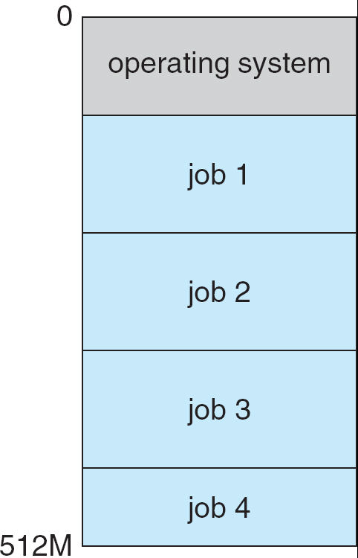
Memory Layout for Multiprogrammed System

Slide 39
Operating-System Operations
Interrupt driven by hardware
Software error or request creates exception or trap
Division by zero, request for operating system service
Other process problems include infinite loop, processes modifying each other or the operating system
Dual-mode operation allows OS to protect itself and other system components
User mode and kernel mode
Mode bit provided by hardware
Provides ability to distinguish when system is running user code or kernel code
Some instructions designated as privileged, only executable in kernel mode
System call changes mode to kernel, return from call resets it to user

Slide 40
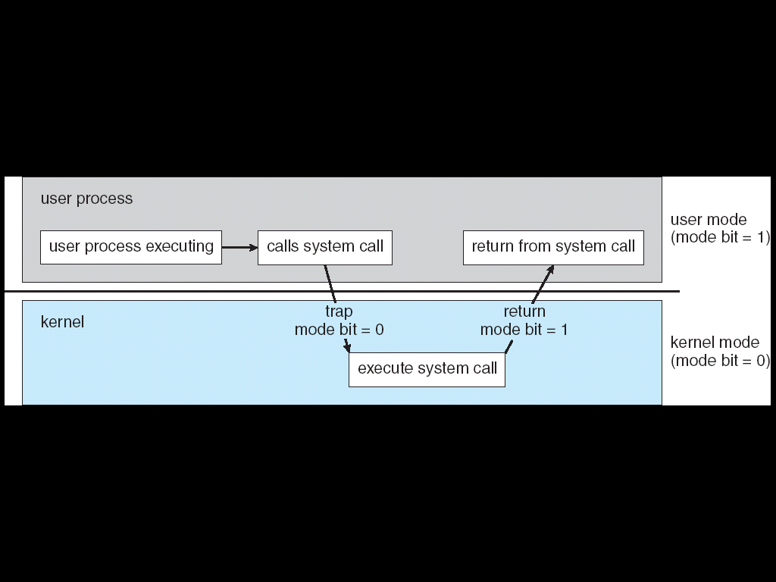
Transition from User to Kernel Mode
Timer to prevent infinite loop / process hogging resources
Set interrupt after specific period
Operating system decrements counter
When counter zero generate an interrupt
Set up before scheduling process to regain control or terminate program that exceeds allotted time

Slide 41
Process Management
A process is a program in execution. It is a unit of work within the system. Program is a passive entity, process is an active entity.
Process needs resources to accomplish its task
CPU, memory, I/O, files
Initialization data
Process termination requires reclaim of any reusable resources
Single-threaded process has one program counter specifying location of next instruction to execute
Process executes instructions sequentially, one at a time, until completion
Multi-threaded process has one program counter per thread
Typically system has many processes, some user, some operating system running concurrently on one or more CPUs
Concurrency by multiplexing the CPUs among the processes / threads

Slide 42
Process Management Activities
The operating system is responsible for the following activities in connection with process management:
Creating and deleting both user and system processes
Suspending and resuming processes
Providing mechanisms for process synchronization
Providing mechanisms for process communication
Providing mechanisms for deadlock handling

Slide 43
Memory Management
All data in memory before and after processing
All instructions in memory in order to execute
Memory management determines what is in memory when
Optimizing CPU utilization and computer response to users
Memory management activities
Keeping track of which parts of memory are currently being used and by whom
Deciding which processes (or parts thereof) and data to move into and out of memory
Allocating and deallocating memory space as needed

Slide 44
Storage Management
OS provides uniform, logical view of information storage
Abstracts physical properties to logical storage unit - file
Each medium is controlled by device (i.e., disk drive, tape drive)
Varying properties include access speed, capacity, data-transfer rate, access method (sequential or random)
File-System management
Files usually organized into directories
Access control on most systems to determine who can access what
OS activities include
Creating and deleting files and directories
Primitives to manipulate files and dirs
Mapping files onto secondary storage
Backup files onto stable (non-volatile) storage media

Slide 45
Mass-Storage Management
Usually disks used to store data that does not fit in main memory or data that must be kept for a “long” period of time.
Proper management is of central importance
Entire speed of computer operation hinges on disk subsystem and its algorithms
OS activities
Free-space management
Storage allocation
Disk scheduling
Some storage need not be fast
Tertiary storage includes optical storage, magnetic tape
Still must be managed
Varies between WORM (write-once, read-many-times) and RW (read-write)

Slide 46
I/O Subsystem
One purpose of OS is to hide peculiarities of hardware devices from the user
I/O subsystem responsible for
Memory management of I/O including buffering (storing data temporarily while it is being transferred), caching (storing parts of data in faster storage for performance), spooling (the overlapping of output of one job with input of other jobs)
General device-driver interface
Drivers for specific hardware devices

Slide 47
Protection and Security
Protection – any mechanism for controlling access of processes or users to resources defined by the OS
Security – defense of the system against internal and external attacks
Huge range, including denial-of-service, worms, viruses, identity theft, theft of service
Systems generally first distinguish among users, to determine who can do what
User identities (user IDs, security IDs) include name and associated number, one per user
User ID then associated with all files, processes of that user to determine access control
Group identifier (group ID) allows set of users to be defined and controls managed, then also associated with each process, file
Privilege escalation allows user to change to effective ID with more rights

